Slide 1
DB Management Systems: Speedrun
Joel Klein – jdk514@gwu.edu

Slide 2
Database Services in AWS
Notes:
Introduce myself – education, work experiences, etc.

Slide 3
IaaS, PaaS, DBaaS
Since the late 2000’s companies have been shifted away from simply providing software as their service and begun looking at new ways to abstract IT into service based models
Infrastructure as a Service (IaaS): Providing a service for managing IT infrastructure without needing to manage the hardware
Platform as a Service (PaaS): Providing a service for managing and running applications without needing to manage the infrastructure
Database as a Service (DBaaS): Providing a service for managing data without needing to manage software or hardware.

Slide 4
Implementing Cloud Databases
While there is a specific name for databases in the cloud, DBaas, just like with everything else this is not the only way to do things
AWS Database solutions:
Relational Database Service (RDS):
Athena:
Dynamo

Slide 5
RDS

Slide 6
Relational Database Service (RDS)
RDS, despite its name, falls into the PaaS category. This is because it allows people to spin up VM’s running DB applications.
For RDS instances, we dictate the type of machine and the storage. However, the database software is installed and managed by AWS.
In addition, backups and restores are also managed via AWS services. Although you can still run manual backup processes
With this setup, the database works exactly as if you setup the application, but you do not need to manage the software and only need to specify the hardware.

Slide 7
Current Problems with RDS-like Solutions
While RDS provides an easy and effective way of deploying relational databases, there are some larger consequences.
Systems like RDS use open source software, like Aurora DB, to provide their managed solutions. While this doesn’t void the warranty of the software’s license (at least currently), it does have a larger effect.
Most open source software is maintained through paid support and/or features. Tools like RDS disrupt this workflow and are actually suctioning money away from open-source projects.

Slide 8
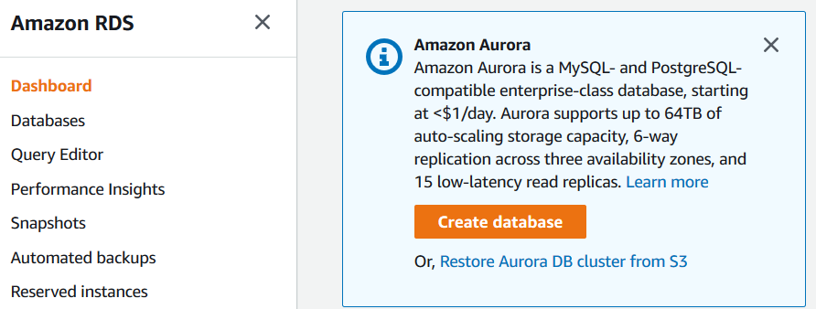
Accessing RDS
From the RDS service page we are given a high-level overview of our RDS resources (this is the dashboard)
On the left-hand pane, we can see a couple of options. For us, the primary menu will be the Databases page

Slide 9
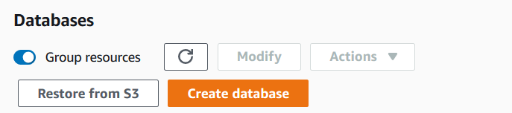
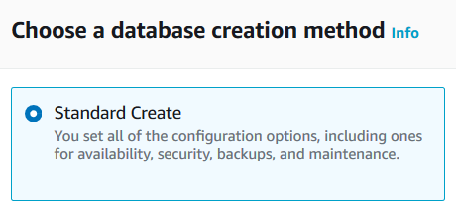
Creating a Database Instance
From the Databases page, we should see the option to Create database. This option opens up the workflow to create a database instance
For most of our use-cases we probably want to do a Standard Create as that gives us more control over the settings that influence cost!
From here the options begin to grow, as we have multiple databases to choose from, each with their own requirements

Slide 10
RDS for this Class
Engine: MySQL
Template: Free tier
DB Instance Size: db.t2.micro
Storage: General Purpose @ 20GB
VPC: Class Generated VPC (which opens up MySQL port)
Authentication: Password

Slide 11
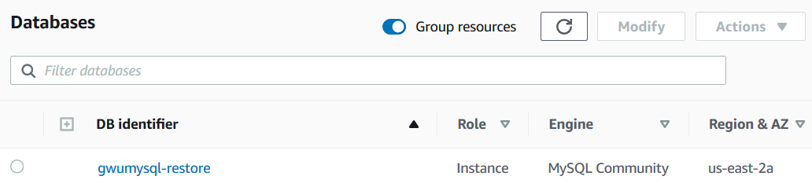
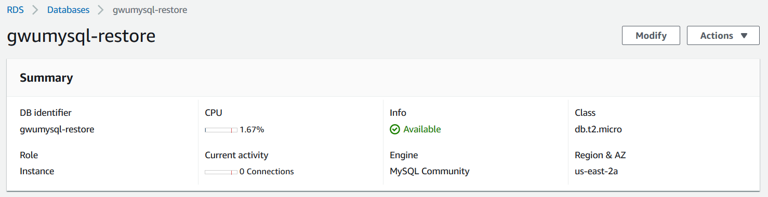
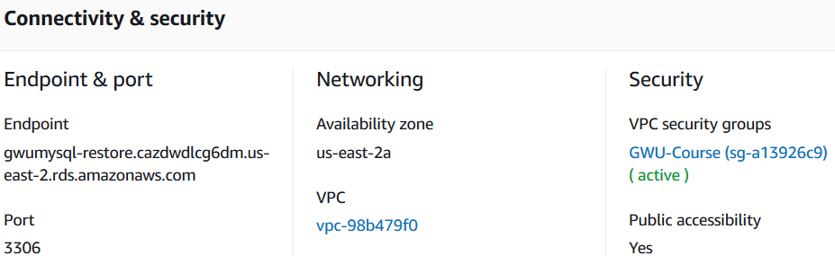
Accessing An Instance
Going back to the Databases page, we should now be able to see our instance.
By Clicking into our instance, we can get additional details about the running instance.
From here we can even find connectivity information.

Slide 12
Discuss Pros/Cons of RDS

Slide 13
ATHENA

Slide 14
Athena
AWS Athena is probably most accurately defined as a DBaaS, however it fills a niche that makes it somewhat difficult to categorize
Athena is a system developed to enable users to query flat files stored in S3. In this way, users do not need to perform any ETL processes to leverage their data.
However, this system is not nearly as efficient as a database and has numerous drawbacks.
NOTE: Parquet helps eliminate some of these drawbacks

Slide 15
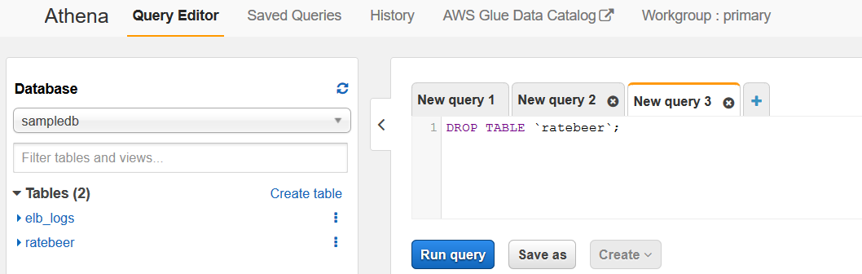
Accessing Athena
The landing page for the Athena service is a little different than other AWS services, as it dumps you directly into a SQL editor.
The reason for this is that AWS Athena is tightly integrated with AWS Glue
AWS Glue is an AWS ETL service that can also help automate the creation of Athena queryable tables

Slide 16
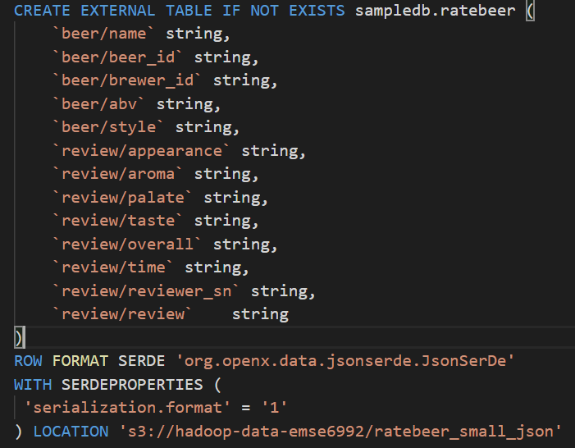
Creating an Athena Table
Athena tables can be generated a couple of ways:
AWS Glue: Glue can scrap S3 buckets and generate meta data/schemas that can be leveraged by Athena
Athena Query: You can run SQL commands to generate Athena tables directly
Athena Table Creation: Workflow that will generate the SQL for you

Slide 17
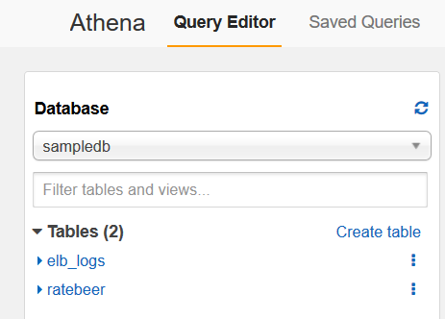
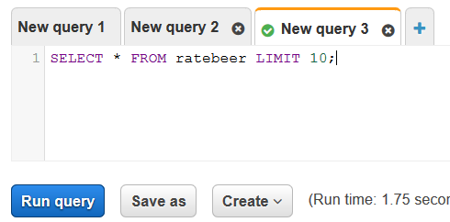
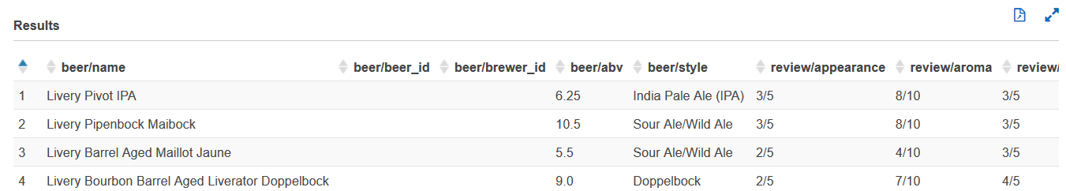
Accessing AWS Tables
Athena tables are viewable on the left-hand pane on the main landing page
You can click in on any of the tables, or simply write a query directly in the Query Editor.
Just like MySQL Workbench, the resultset appears on the bottom of the page

Slide 18
Discuss Pros/Cons of Athena

Slide 19
Dynamo (Key-Value Store)

Slide 20
Dynamo
Dynamo is a Key-Value Database System
Key-Value means that records are broken down into a key (identifier) and a value (data)
Key-Value may commonly look like Document Databases, however they are typically only queryable against the key/very specific indexes.
The key design of Dynamo is an easily scalable system, where the data does not conform to a set structure

Slide 21
Terminology
Table: Collection of Key-Value items
Item (Record): A group of attributes that is tied to an identifier (a key)
Attribute: Fundamental data element, our basic unit of information
Primary Key: The unique identifier of an Item
Partition Key: Key that dictates how data is distributed throughout Dynamo (really an optimization issue)
Sort Key: Similar to partition key, but dictates how data is organized (Items cannot share same partition and sort key)
Secondary Keys/Indexes: A secondary key enables the use of a secondary key for querying data
Query: A command to extract information from a Database generally limited to the primary key

Slide 22
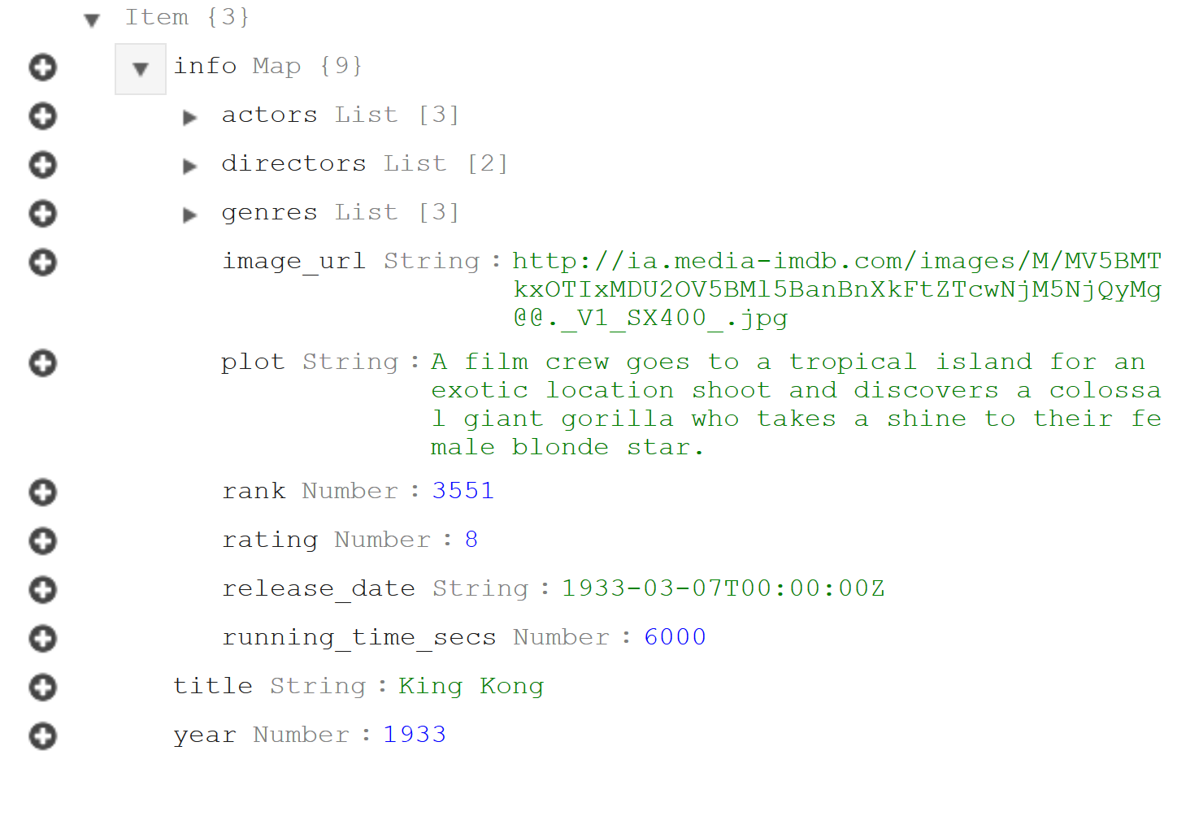
Dynamo Table Layout
As mentioned earlier, each Item/Record in Dynamo is comprised of a Primary Key and Attributes (and possibly a sort/secondary key)
Nothing identifies a key within the Item. As we can see on the right, the keys have no distinguishing attributes (‘title’ and ‘year’)
The remaining attributes in the Item are stored within the field ‘info Map’, but that is just the structure of this Item
All attributes must have a type (String, Number, Binary)

Slide 23
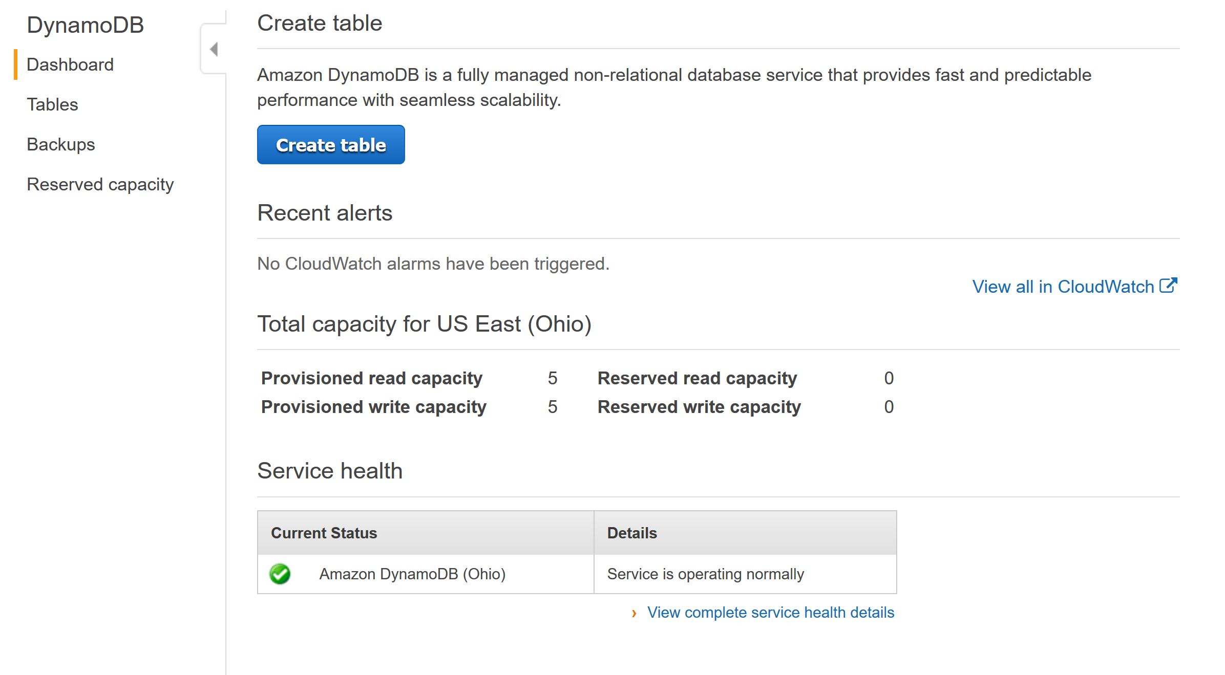
Dynamo Dashboard
The Dynamo dashboard in AWS gives a quick overview of the current status of your Dynamo setup
From here it is quite easy to create a table
We can also view the capacity of running Dynamo tables
Read and Right capacities are in X per second

Slide 24
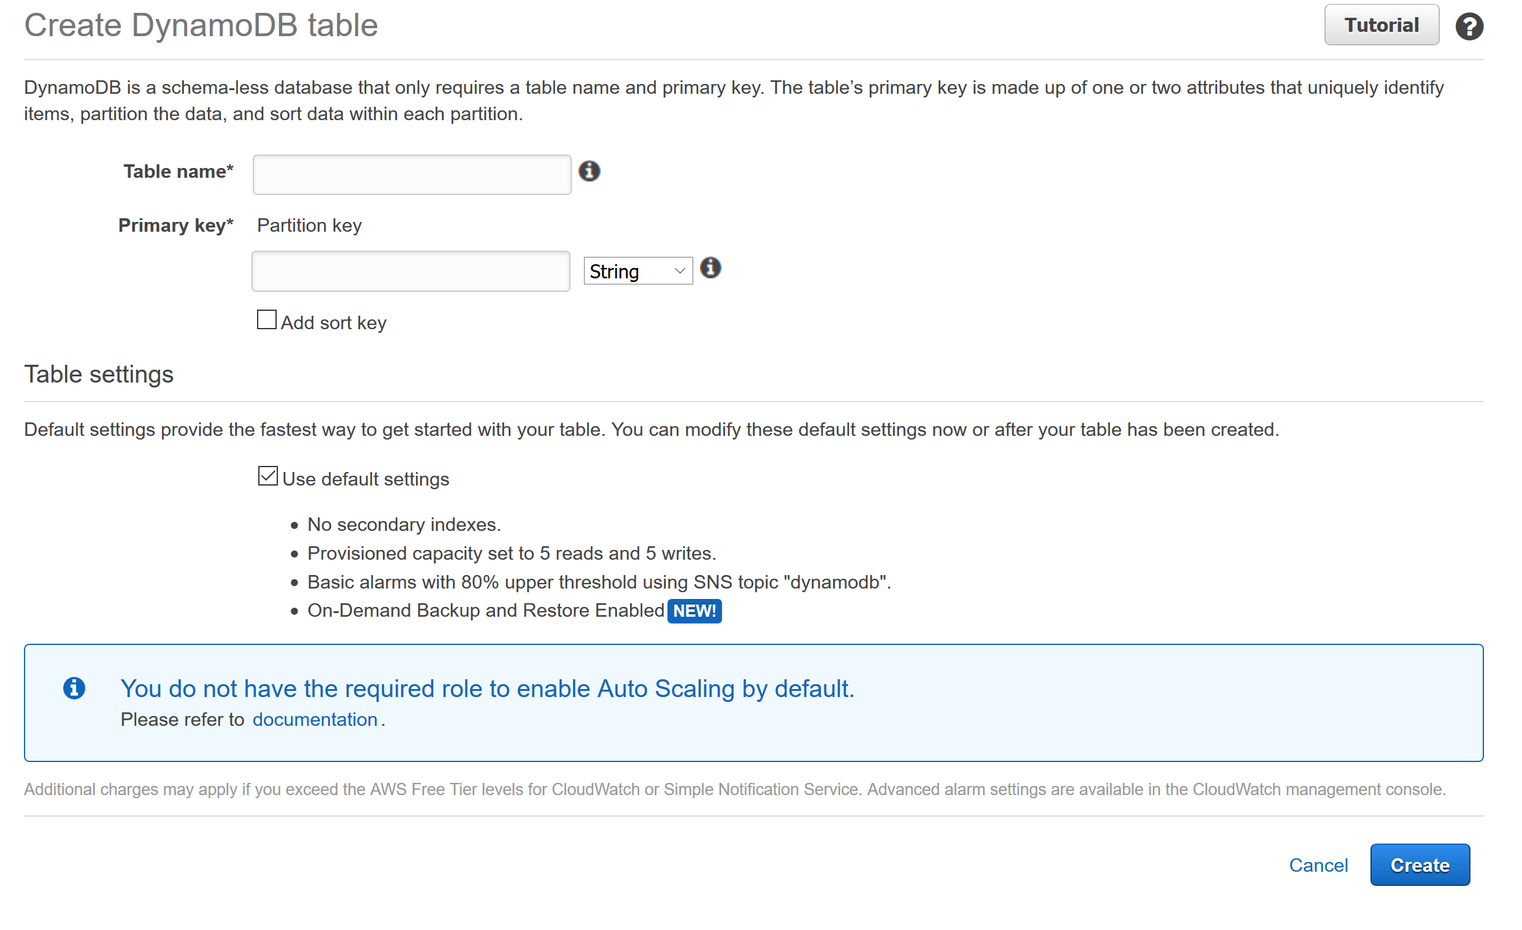
Creating a Table

Slide 25
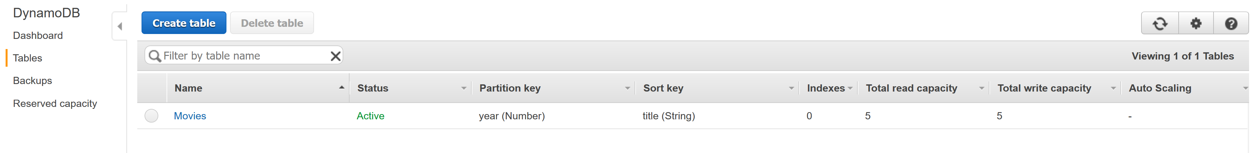
Viewing Tables
From the Tables page on the Dynamo dashboard we can view our current tables
This gives a view of the tables Partition and Sort Keys, as well as Indexes and Capacity
This also enables us to click through to a Table viewer

Slide 26
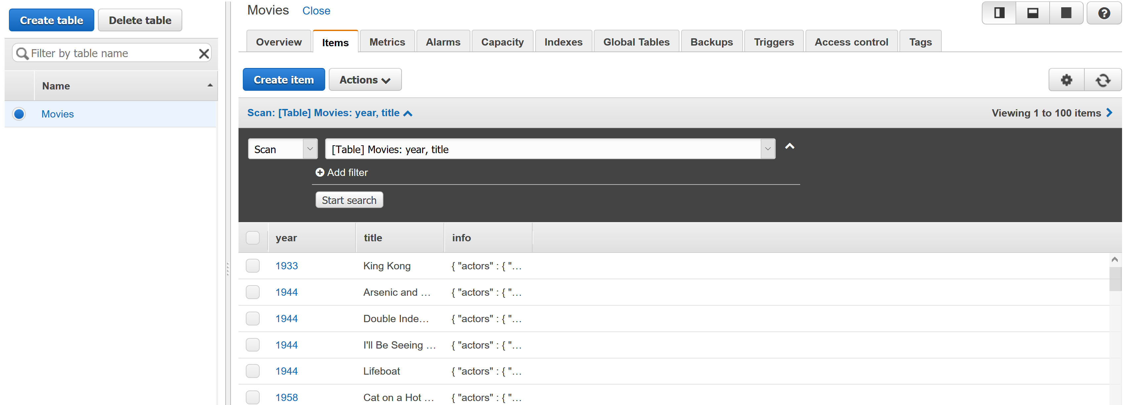
Viewing Tables
From the Table view we have the Items tab, which gives us access to the following features:
Create Item
Scan/Query the data
Edit/Duplicate data
View an item

Slide 27
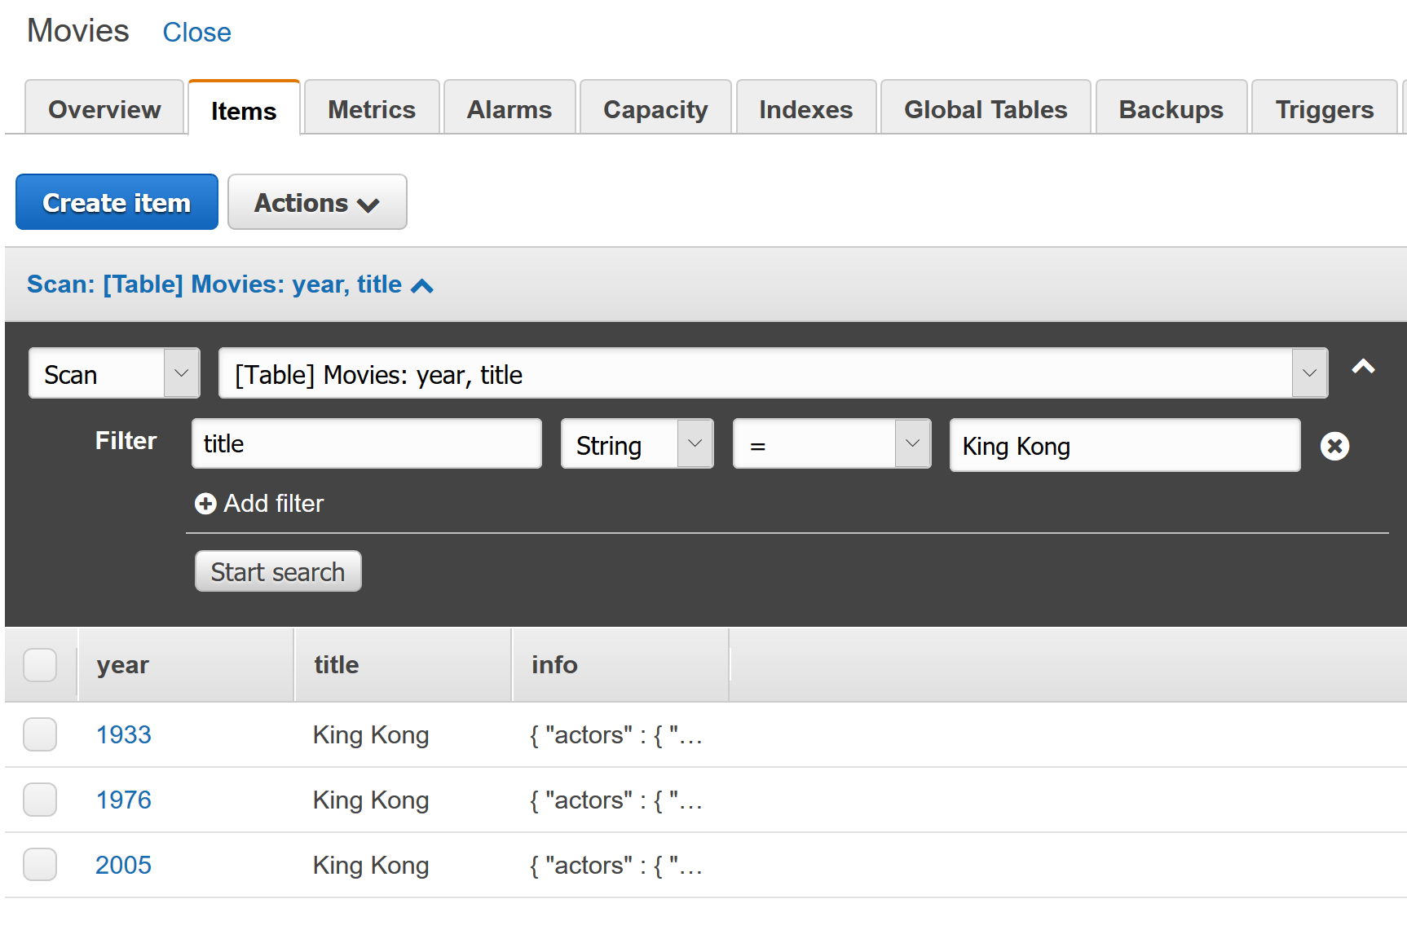
Scanning/Querying
From the Items tab we can also query/scan for items
To accomplish this we simply need to state what filters we want applied
Filters are case-sensitive
Filters can only be applied to keys/indexes
A Scan will take a while to find all items
A Query will be more/less instantaneous, but requires sort and primary key to be defined

Slide 28
Discuss Pros/Cons of Dynamo

Slide 29
Kafka (Eventing Database)

Slide 30
Eventing Systems
The database systems we've explored so far have been concerned with representing data only at the current moment in time.
Any updates or modifications to a record update it and no information about the previous state is maintained.
Eventing systems however are focused on logging information as events or changes occur. The data in eventing systems are immutable.
This means that they store interactions over time, rather than just the current state for a record.

Slide 31
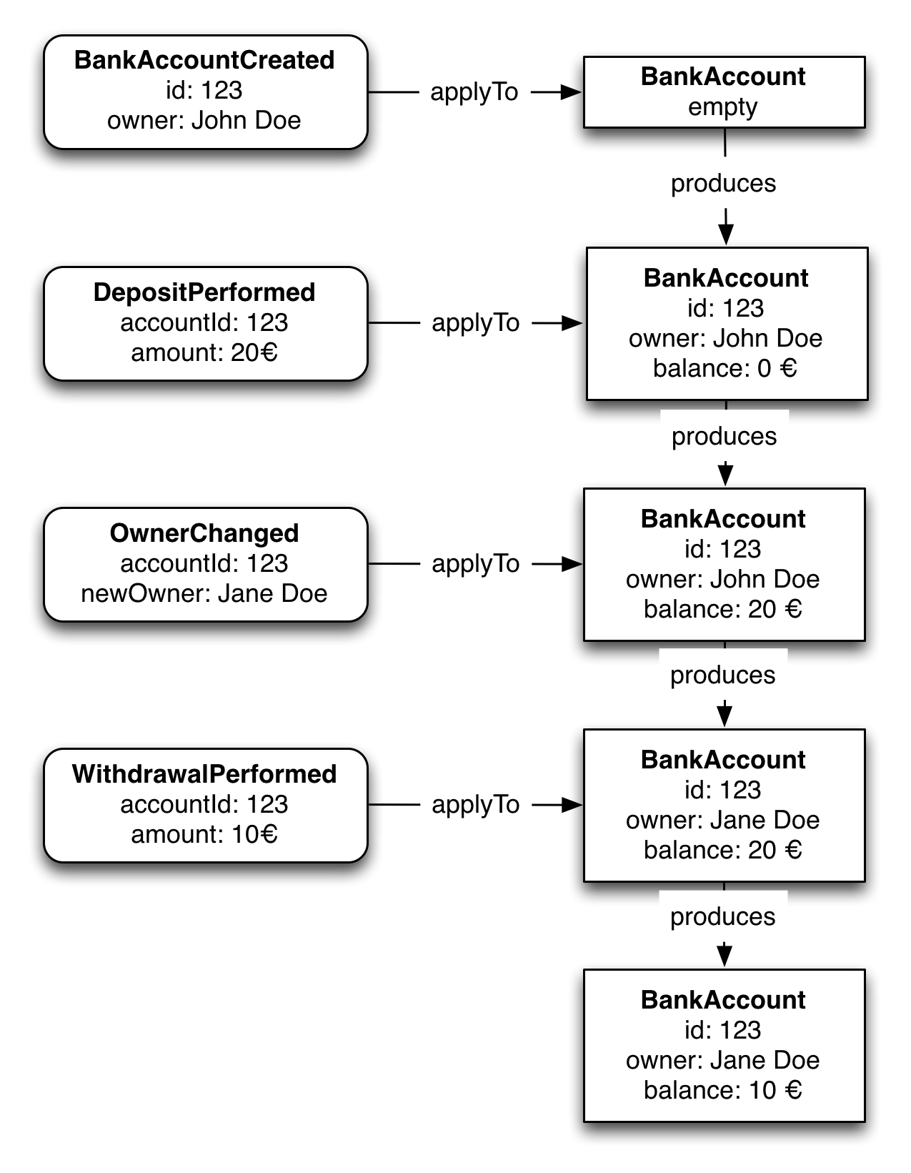
Event Sourcing
One of the advantages of eventing databases like Kafka is their ability to support event sourcing
Event sourcing is an approach for data management that logs all the state changes of an entity within the system.
Within an event sourcing we can merge events into a new state through an Aggregate (a representation of entities made by playing back events).
A projection is an aggregate designed to read the current state

Slide 32
Discuss Pros/Cons of Kafka

Slide 33
SQLite (Embedded Databases)

Slide 34
SQLite
SQLite is considered an embedded database system as it does not require a server to operate, instead SQLite is managed through code and files.
A SQLite database is simply a local file with a .sqlite extension
Rather than executing queries against a server, queries are managed by the software and update the .sqlite file accordingly
This setup is commonly used in embedded devices as it doesn't require running additional software.
It's actually a fairly common database design for mobile applications.

Slide 35
Discuss Pros/Cons of SQLite

Slide 36
End Slide DBMS for Data Analytics

